Slide 1

State Innovation Model (SIM)
Central Maine Healthcare
Diabetes Prevention Program
Louise E. Ingraham, MS, RDN, LD, Program Coordinator
Claire E. Poulin, DPP Participant 2015-16
December 6, 2016

Slide 2


Approach / Implementation
2013 National DPP began at CMH Employee Health / Healthy Decisions Wellness Program
  seven lifestyle coaches trained in March 2013
  one facilitated 4 programs that year
Program Coordinator hired July 2014
Master Trainer Select (MTS) trained October 2014
SIM contract effective October 1, 2014
  First Lifestyle Coach Training November 2014
  Funding used for:
    Purchase training and teaching / participant materials
    Travel expenses to Bar Harbor and Presque Isle

Slide 3
Approach / Implementation
Presented 9 Lifestyle Coach Trainings over 2 years
  One at Mt. Desert Island Hospital (Bar Harbor)
  One at The Aroostook Medical Center (Presque Isle)
  Seven at Central Maine Medical Center (Lewiston)
84 coaches trained within the 2 year contract
(goal > 32)
  Average of 9 new coaches per training
  (goal 6 - 12)

Slide 4
Approach / Implementation
Other Organizations Trained 2014 - 2016 |  |  | CMH & Affiliates
Blue Hill Memorial Hospital | GD - BIW | Midcoast Hospital | CMMC and various practices
Bucksport Regional Health Center | Healthy Acadia | Pen Bay Healthcare | DFD Russell Medical Centers
Cary Medical Center | Home Health Visiting Nurses | St. Mary’s Regional Medical Center/Bates | Healthy Androscoggin
Central Maine Conditioning Clinic, Inc. | LL Bean | Stephens Memorial Hospital | Tri-County Mental Health Services
Eastport Health Care | Mayo Regional Hospital | Waldo County General Hospital | United Ambulance Service
EMHS - Beacon Health | MDI YMCA

Slide 5
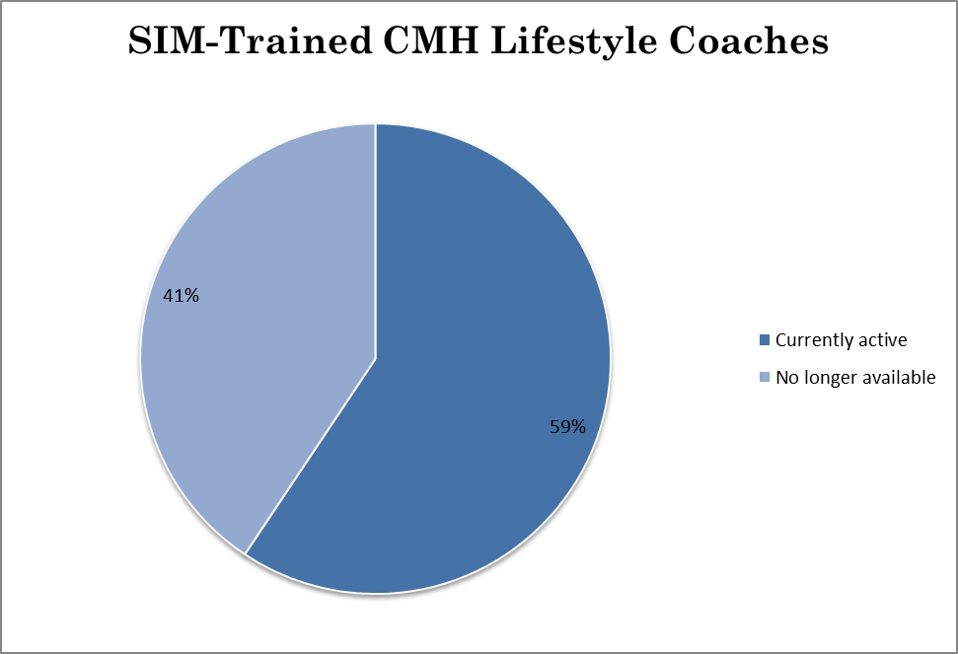
SIM-trained new coaches affiliated w/Central Maine Healthcare
Approach / Implementation
32 trained
19 Active
13 Not available
    Left their organization OR
    Changed job duties or position

Slide 6
Approach / Implementation
Since October 2014
  17 programs have started in 6 communities
  11 CMH SIM-trained coaches as facilitators
    +2 coaches trained by MaineGeneral Master Trainer Select (also SIM-funded)
  Healthy Androscoggin grant from US CDC
    Racial and Ethnic Approaches to Community Health (REACH)
    DPP pilot for Somali participants with Somali lifestyle coach at B Street Clinic

Slide 7
Benefits
Increased capacity to provide the National DPP throughout the state
March 2016 CMH DPP achieved Full Recognition from the CDC Diabetes Prevention Recognition Program (DPRP)
    Met 11 required standards
    Prepares us for reimbursement through
      Third party payers (WellStarMe, other insurance)
      Medicare Diabetes Prevention Program, scheduled to begin January 1, 2018

Slide 8
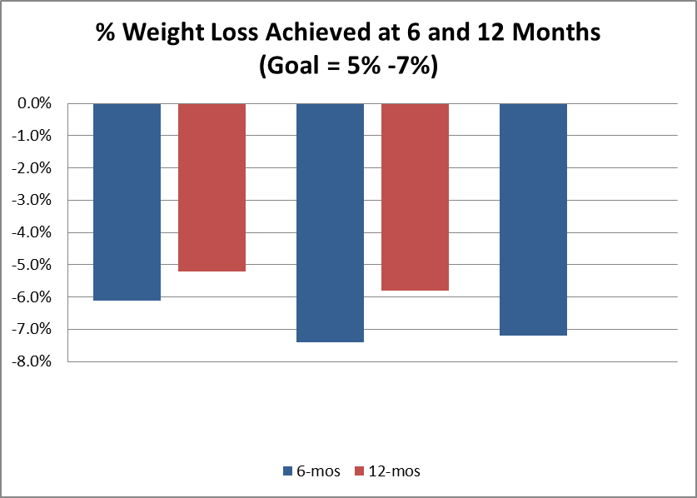
Benefits
Participants reduced their risk for type 2 diabetes
    Reduced A1c, blood pressure, LDL cholesterol reported
    Weight loss
Key:
2013-14 n=28, n=4 (reported to DPRP March 2014)
2014-16 n=7 (reported to DPRP March 2016)
2016-17 n= 13 (6 month data reported to DPRP March 2016)
2013-14 Cohort 2014-16 Cohort 2016-17 Cohort

Slide 9
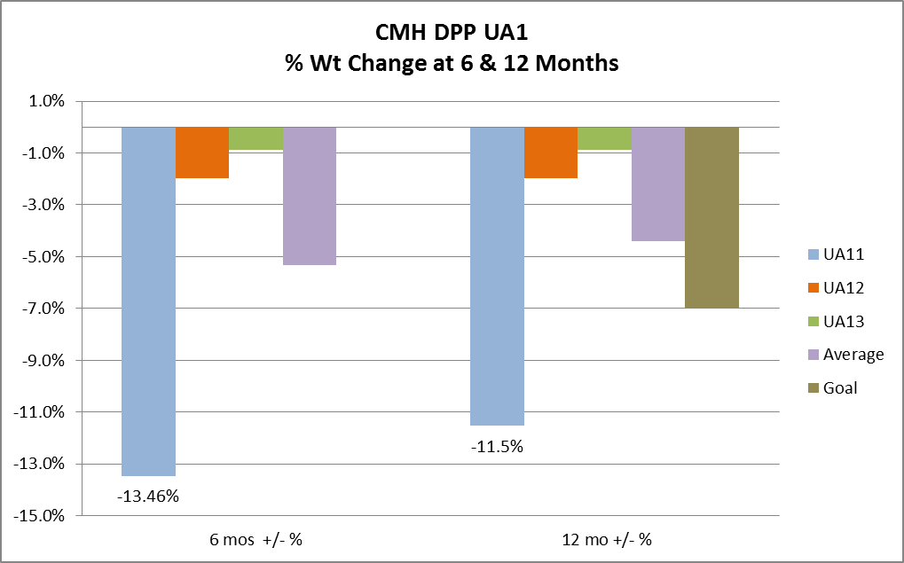
Benefits

Slide 10
Lessons Learned / Recommendations
Printing of materials – expensive
Participant retention remains difficult
Organizations need to find a way to pay Lifestyle Coaches (reimbursement will help)
  As extra duties, DPP becomes lower priority
  Some CMH coaches lead programs after hours on days they don’t work
  Dedicated volunteers can be valuable assets

Slide 11
Next Steps
Business plan developed for SIM grant
  Needs approval from Administration
  Will help fund future Lifestyle Coach Trainings for CMH staff
Continue to expand DPP within the CMH system
  Engage all trained coaches
  Continue outreach to practices and providers
Enroll as Medicare DPP (MDPP) supplier during 2017
  Assist all our coaches as they apply for National Provider Identifier (NPI) numbers

Slide 12

Central Maine Healthcare
Diabetes Prevention Program
Questions?
Louise Ingraham, MS, RDN, LD
10 High Street, Suite 305
Lewiston, ME 04240
207-330-7769
ingrahlo@cmhc.org

